Slide 1
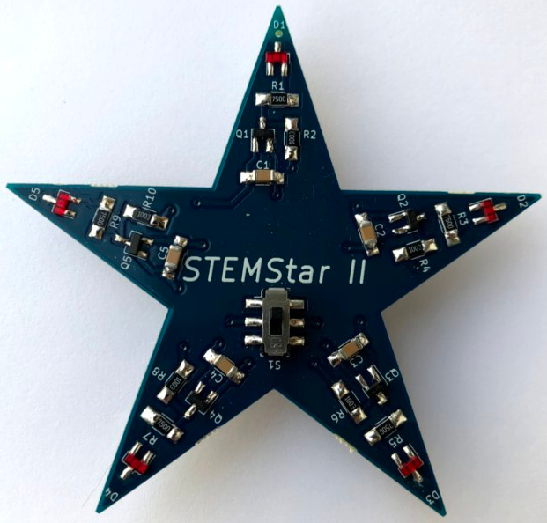
STEMStar II
Designed by:Jim Windgassen
REV - 21 April 2019

Slide 2

Special Thanks
For their kind donation of SIPAD Solid Solder Deposit Service on the STEMStar II Printed Circuit Boards

Slide 3
What is STEMStar II ?
STEMStar II is a fun star shaped circuit board that introduces students to:
  Fundamental electronic components - resistors, capacitors, transistors, and LED’s.
  Modern surface mount circuit boards
  Circuit simulation using LTSpice

Slide 4
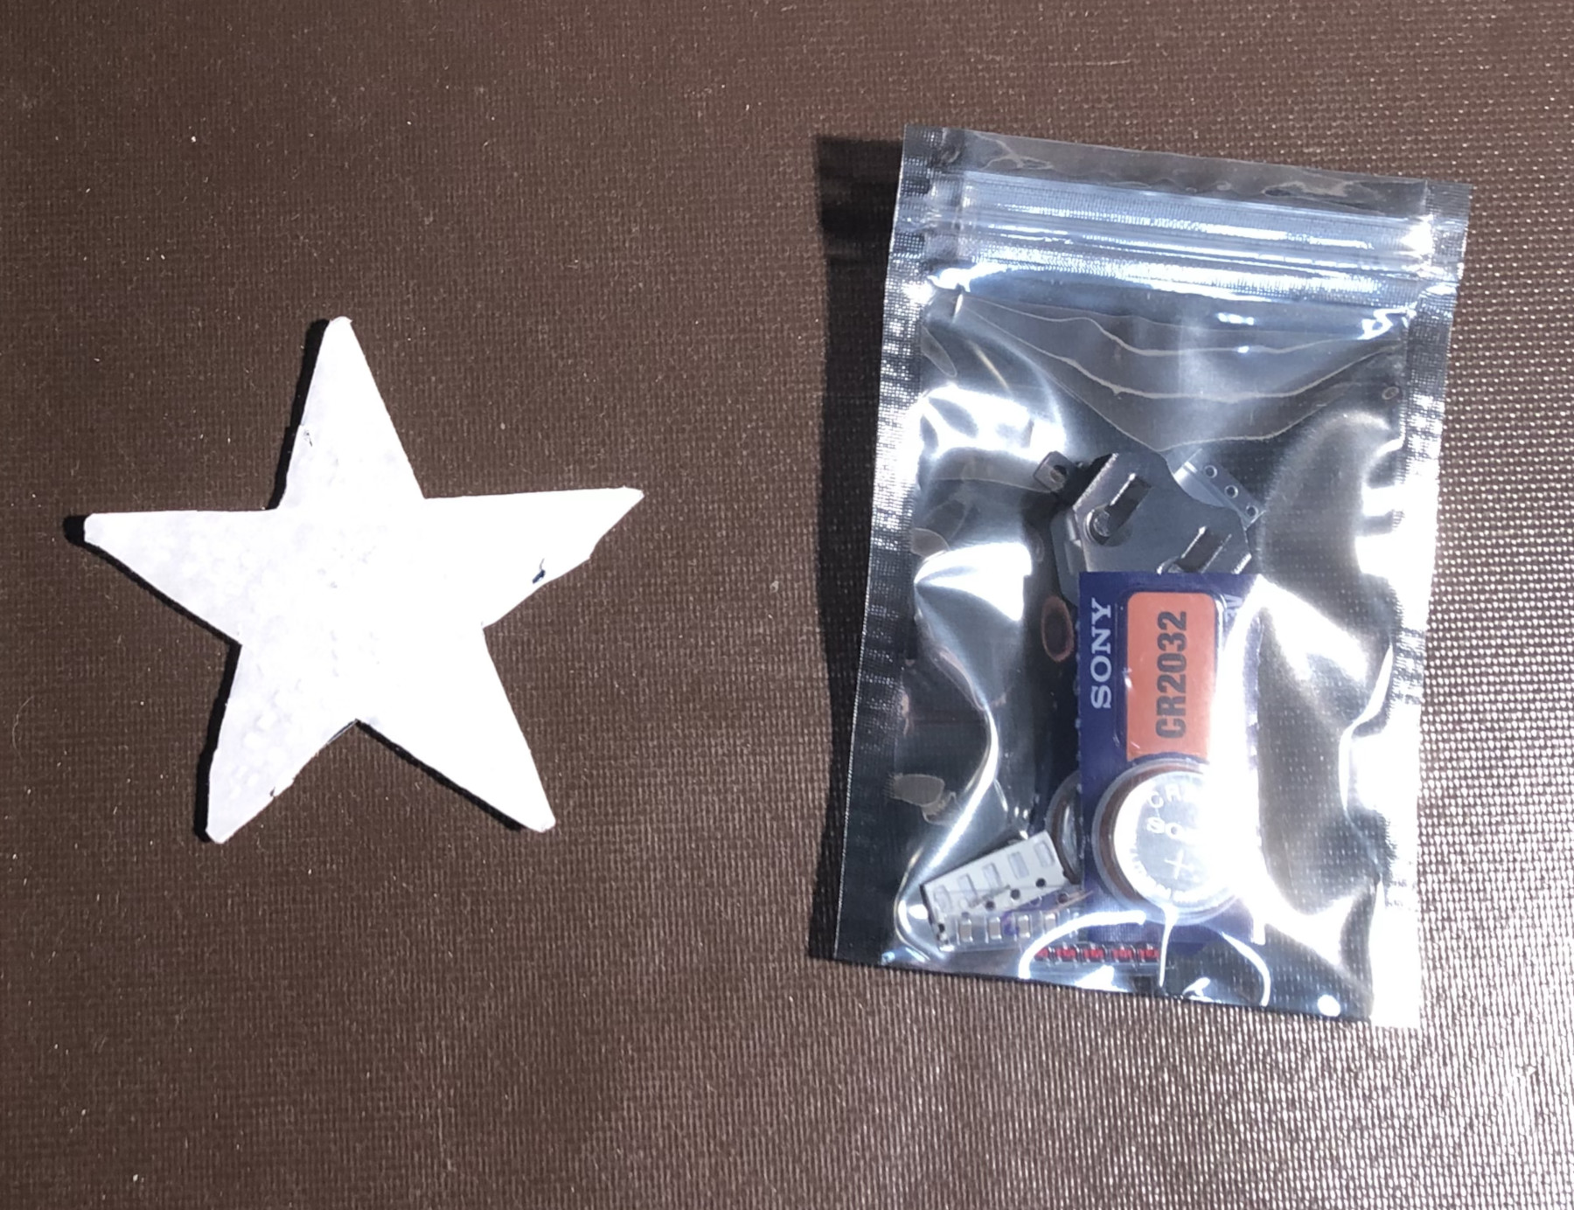
The Kit
The kit consists of a printed wiring board (PWB) covered with protective paper and a small bag of parts

Slide 5
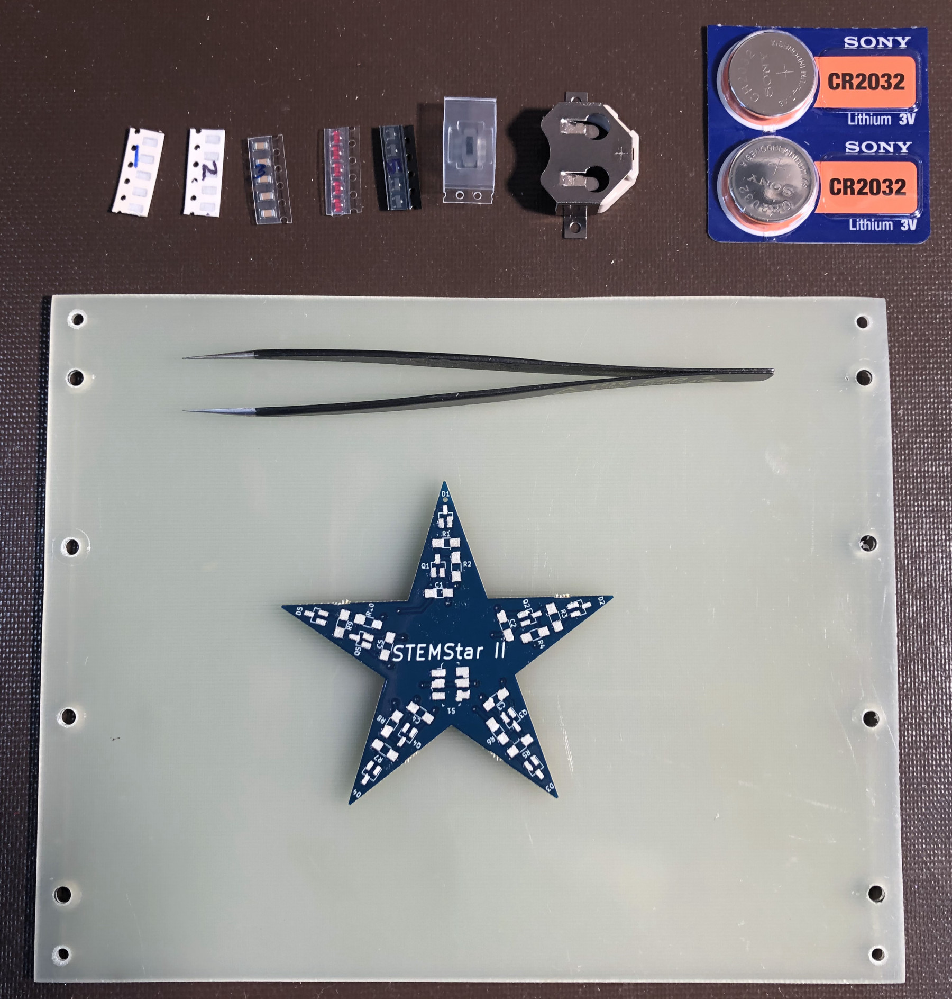
Step 1 - Preparation
Place the Printed Wiring Board (PWB) onto the assembly tray as shown and remove the protective paper.
Remove the parts from the bag and place them in the following order above the tray from left to right:
Find No. 1, 2, 3 are labeled
Find No 4 are the red colored parts
Find No. 5 is the black colored strip
Find No 6 looks like a tiny little switch
Find No. 7 is the large metallic part
Take the time to set
yourself up for success !

Slide 6

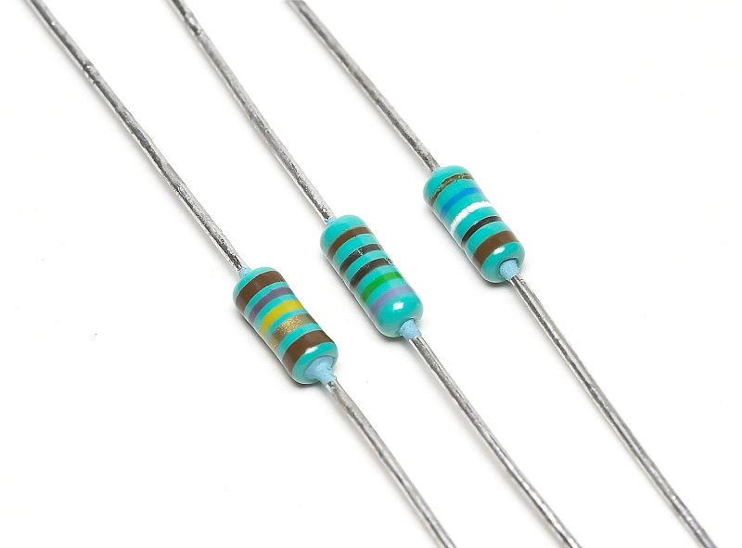
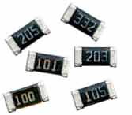
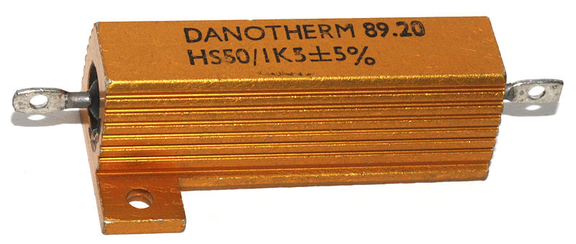
Electronics – Resistor
Resistor – Measured in Ohms – Abbreviated as R
  Resists the flow of electricity
  Think of it kind of like a kink in a garden hose
  A 1 ohm resistor will flow 1 amp when 1 volt is put across it
  Relationship between voltage, current & resistance is Ohm’s Law V = I * R
Thru Hole, Surface Mount, and Power Resistors

Slide 7
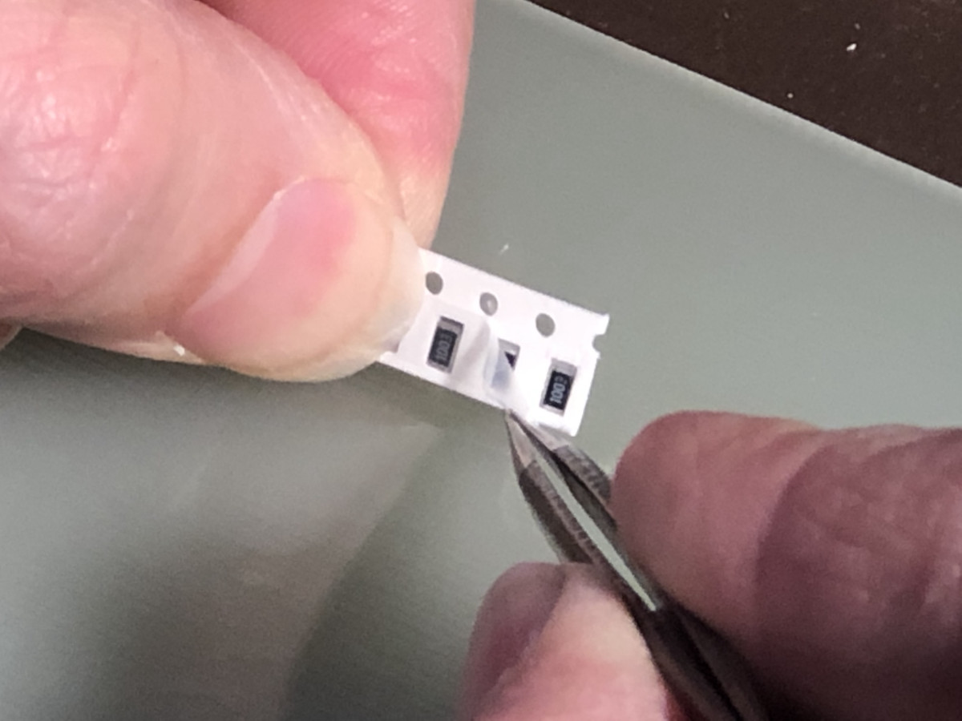
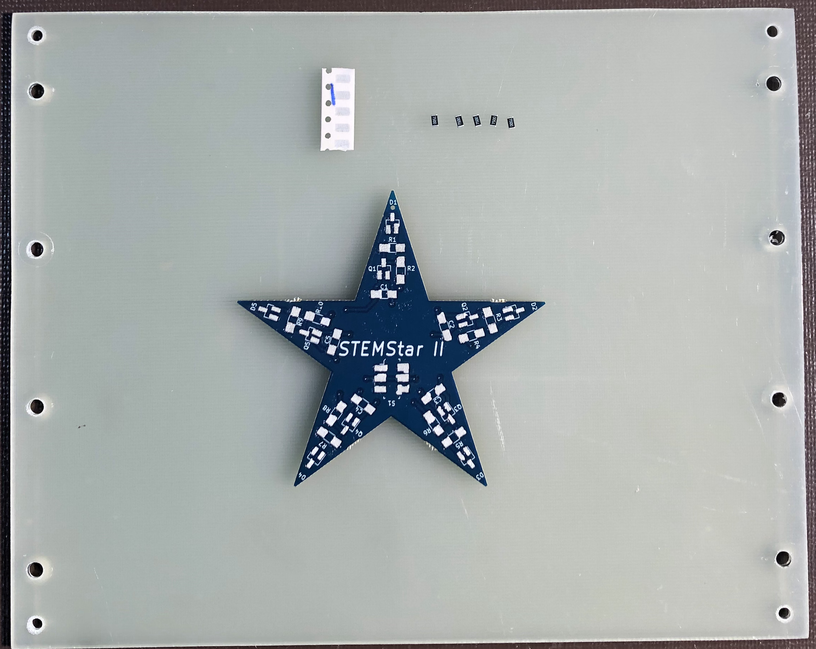
Step 2 – Install Find No. 1
Double check that you have the resistors marked with the “1” on the paper tape. They will also have the number “7500” on each part in the tape to indicate that they are 750 ohms.
Hold the strip of parts just above the tray and use the tweezers to pull back the film covering the resistors and dump them on the tray.
Put the parts in a row above the PWB.
There is no direction for resistors.

Slide 8
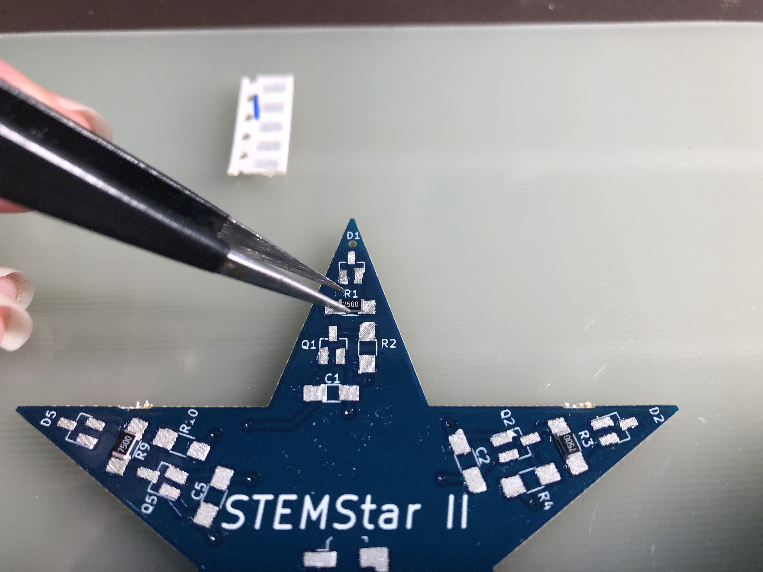
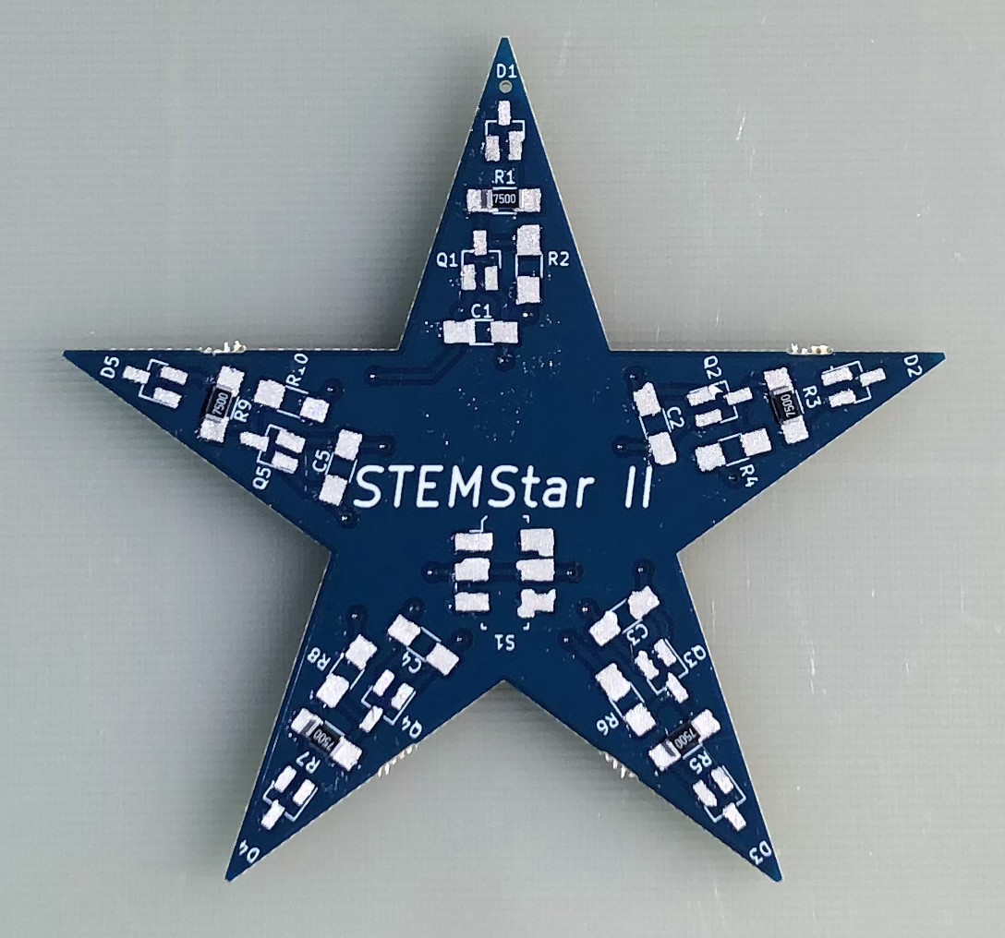
Step 2 (ctd) – Install Find No. 1
Pick up one of the 750 ohm resistors using tweezers, and place it on the pads for R1 as shown above. Gently press the resistor down with the tweezers.
Install 4 more 750 ohm resistors at R3, R5, R7, R9 as shown above.

Slide 9
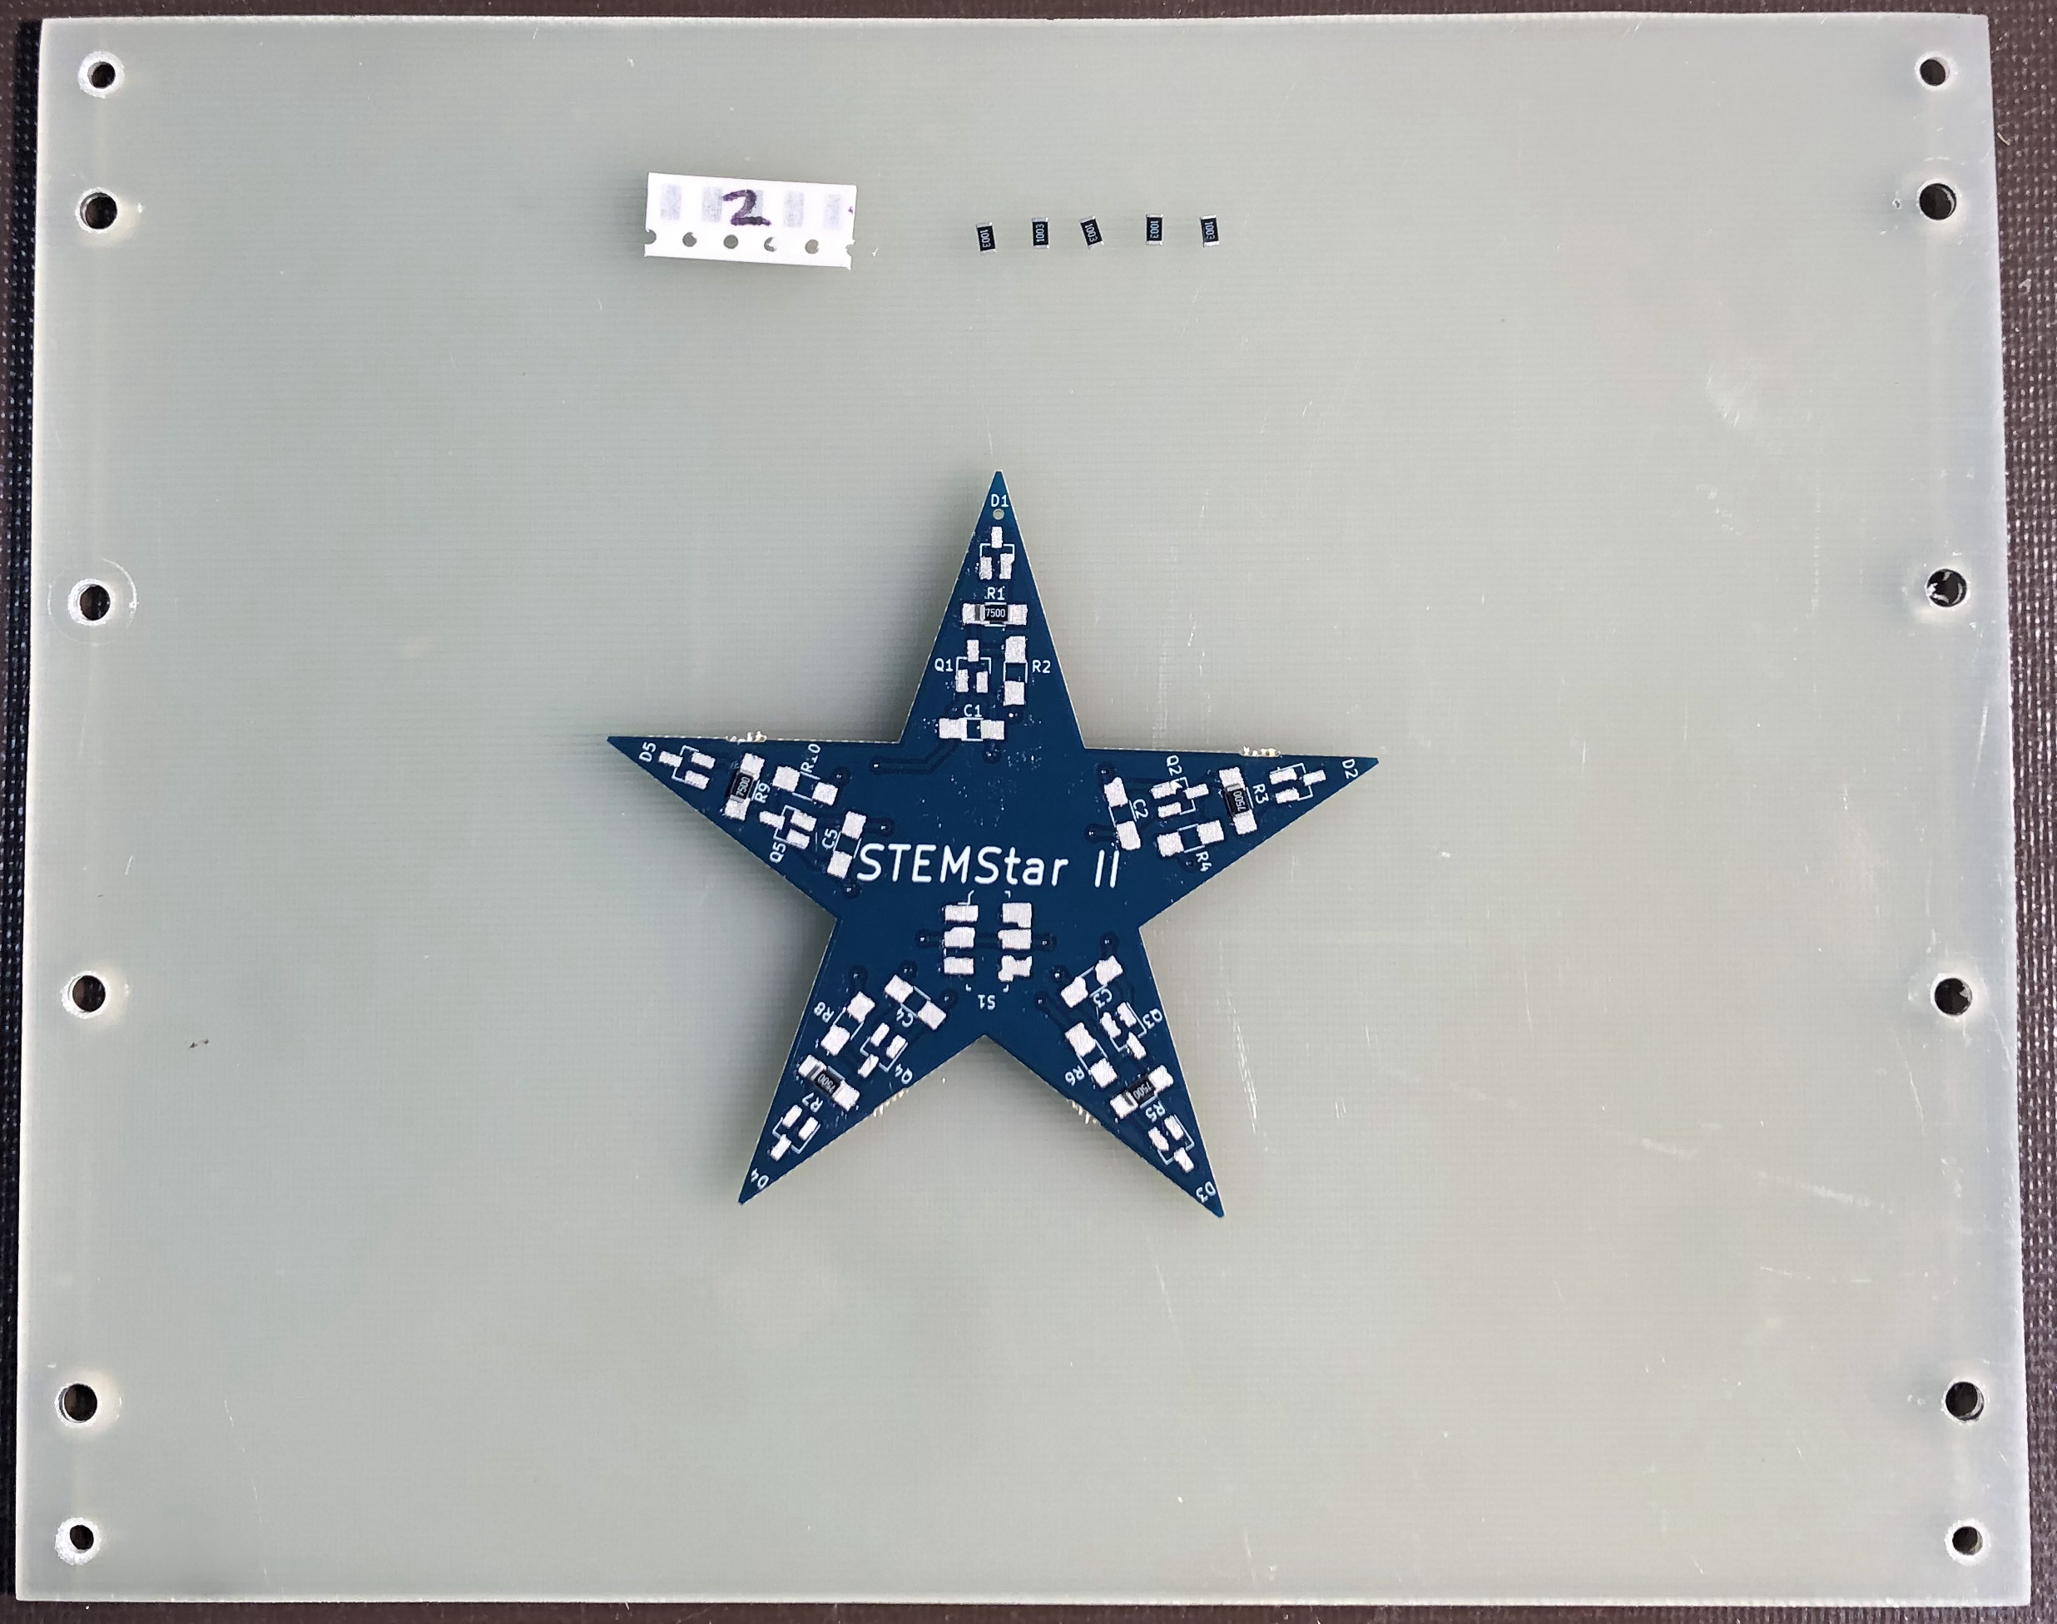
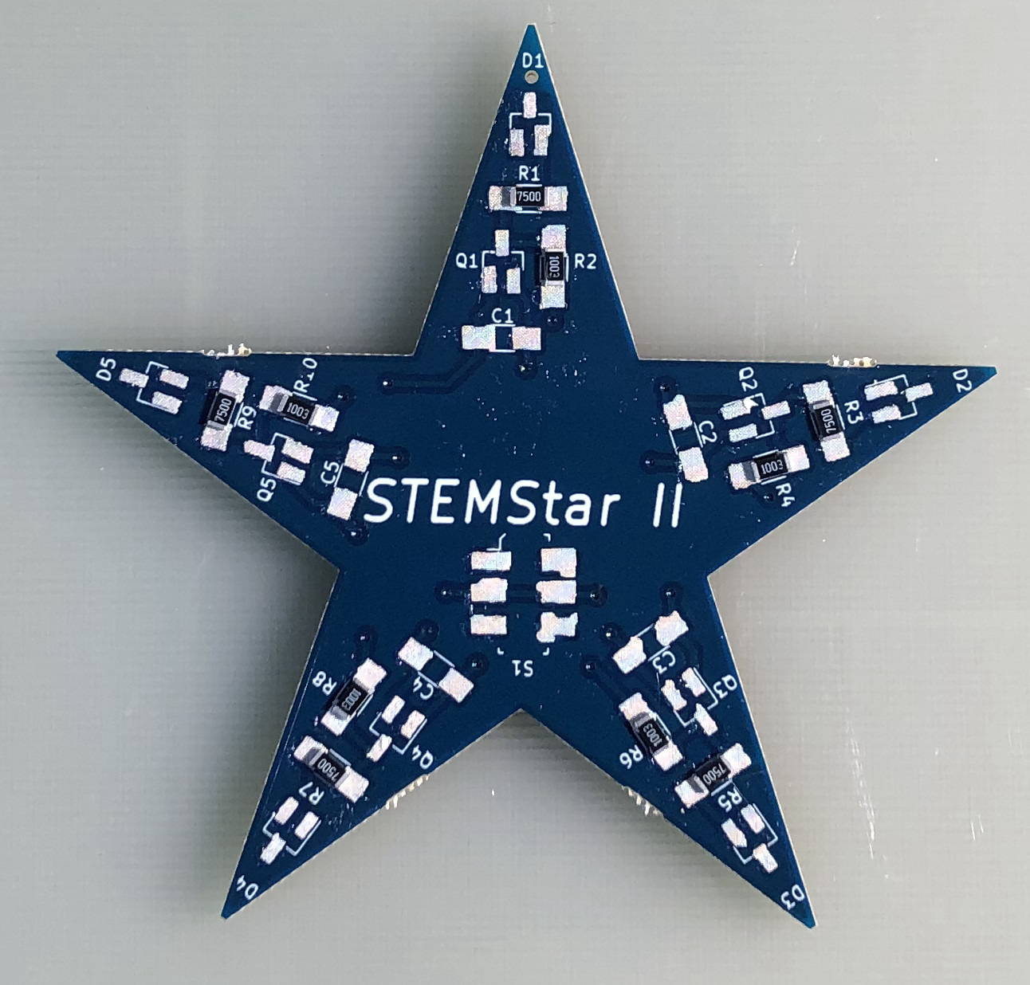
Step 3 – Install Find No. 2
Double check that you have the resistors marked with the “2” on the paper tape. They will also have the number ”1003” on each part in the tape to indicate that they are 100k (100,000) ohms.
Place the parts on the tray as you did before for Find No. 1.
Install the 100k resistors at locations
R2, R4, R6, R8, R10 as shown above.

Slide 10
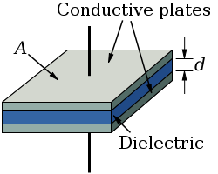
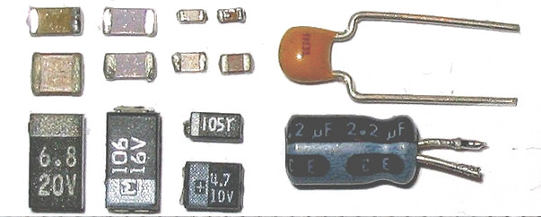

Electronics - Capacitor
Capacitor – Measured in Farads – Abbreviated as C
  We usually speak of capacitors in microfarads (μF) or picofarads (pF)
    1 μF is 1 millionth of a Farad and 1pF is 1 trillionth of a Farad
    DC (constant) currents cannot flow through a capacitor, but AC (alternating) currents can flow through them.
  A capacitor consists of two plates of metal separated by a dielectric (insulator).
Surface Mount and Through Hole Capacitors
Schematic Symbol for a Capacitor

Slide 11
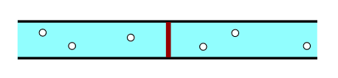
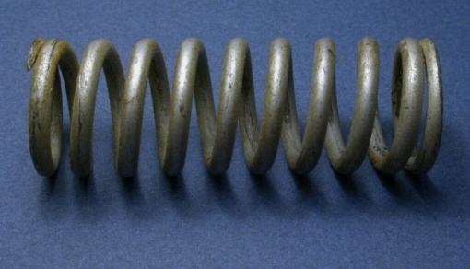
Electronics - Capacitor
Capacitors Store Energy in Electric Fields
  Similar to the way that a spring stores energy by being compressed
  Acts like an energy storage unit that can be charged and discharged very quickly
Two Ways to Visualize a Capacitor in Your Mind
A Rubber Membrane Between Two Sides of a Pipe
A Spring
It may be easier to use one or the other of these visualizations of a capacitor depending on how it is being used in a circuit.

Slide 12
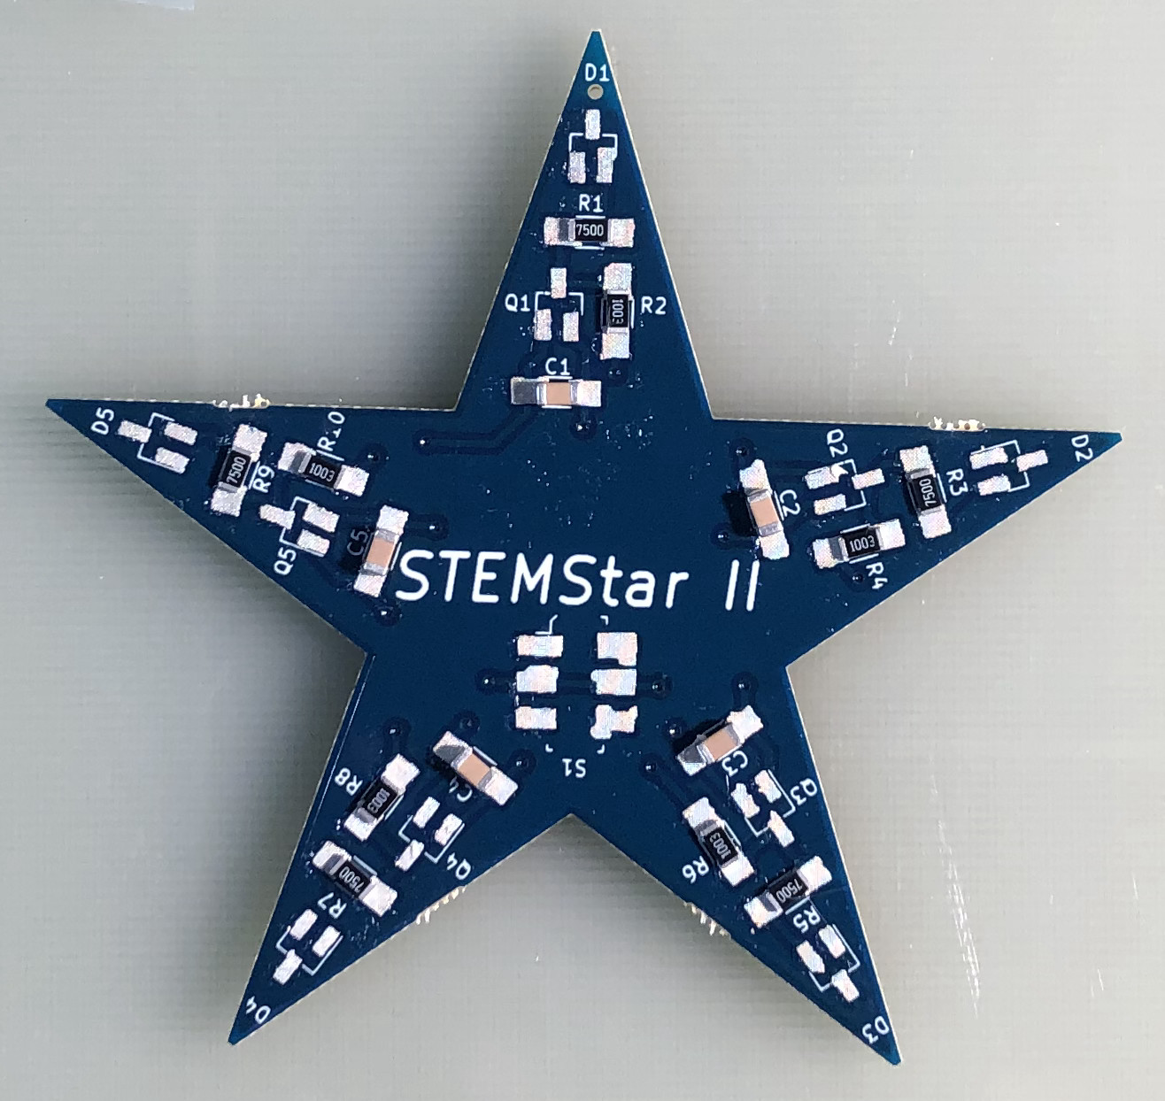
Step 4 – Install Find No. 3
Get Find No 3, 1 micro-farad (1µF) capacitors
Place the parts on the tray as you did before for Find No. 1.
Install the 1µF capacitors at locations
C1, C2, C3, C4, C5 as shown.
There is no direction for these type of capacitors.

Slide 13
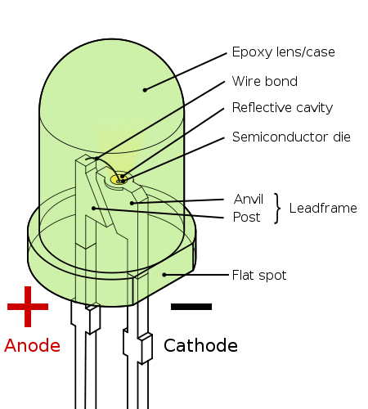
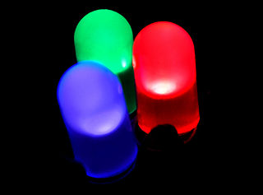
Electronics – Light Emitting Diode (LED)
Light Emitting Diodes (LED’s)
  The LED is a special kind of diode that can emit light
  A diode is an electronic component which only allows current to flow in one direction
  LED’s are available that make almost any color of light
  The color of the LED is determined by the kind of semiconductor material used to make the LED.

Slide 14
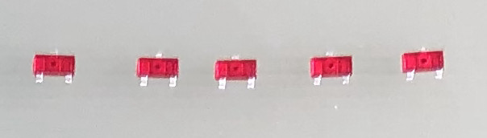
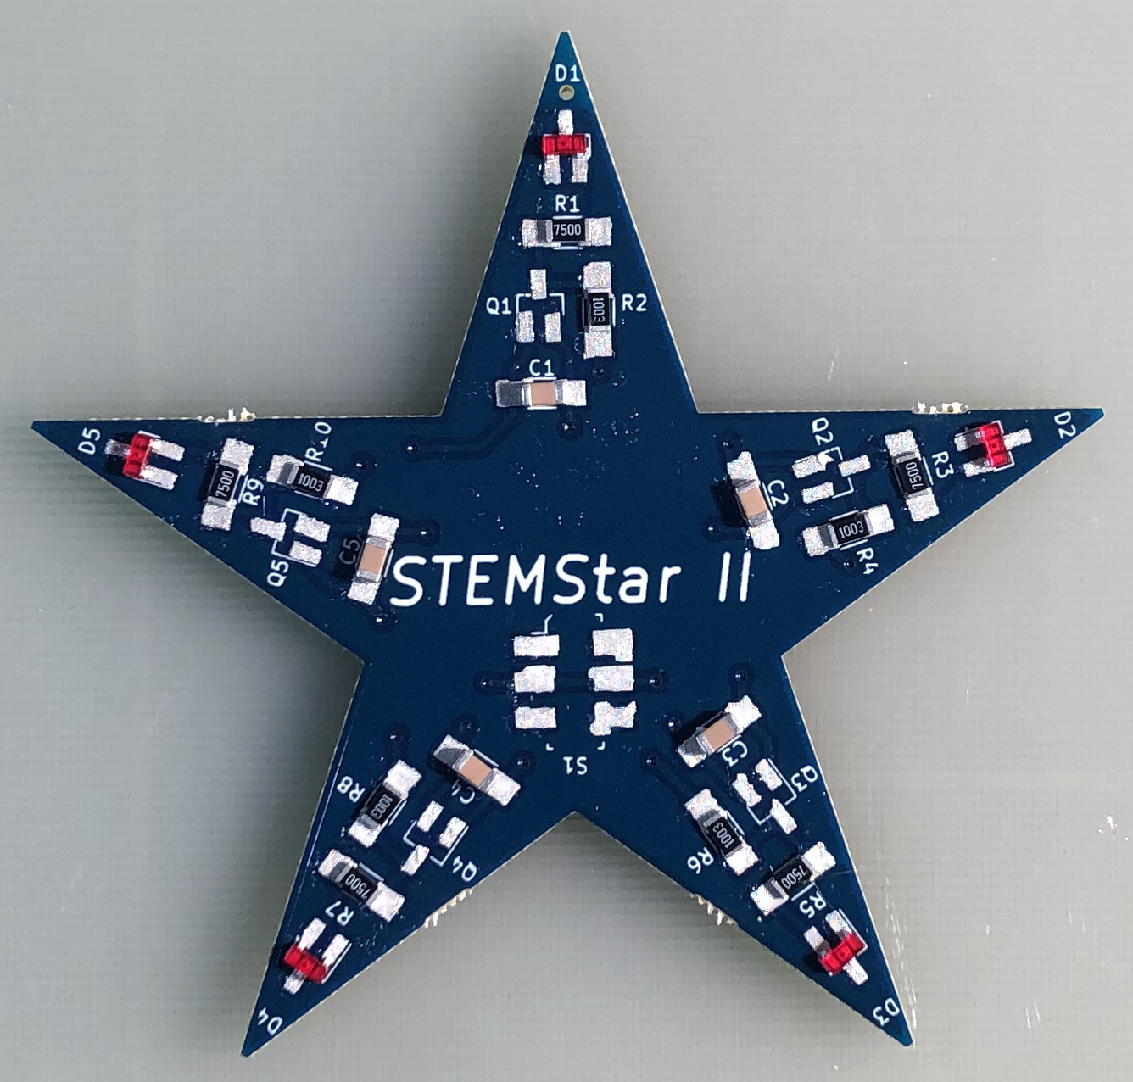
Step 5 – Install Find No. 4
Get Find No 4, red light emitting diodes (LED).
Place the parts on the tray with the leads facing down towards the tray and the side with two leads towards you as shown above.
Install the LED’s at locations
D1, D2, D3, D4, D5
Ensure that the 3 leads on each part are on the pads.
Note – The LED’s are in a 3 leaded package so that they will only fit on the board one way – only 2 of the 3 leads are electrically connected.

Slide 15
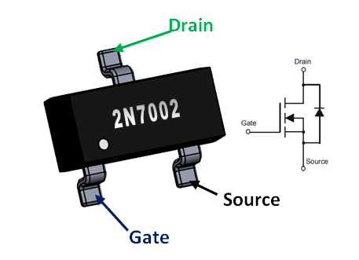
Electronics - MOSFET
A MOSFET is a kind of transistor – a device that acts as an electronic switch
MOSFET is an acronym for Metal Oxide Shielded Field Effect Transistor
The MOSFET has three terminals called Drain, Gate, and Source
When the part is on, current can flow between the Drain and the Source
Turns on when the voltage at the gate is higher than the voltage at the source.

Slide 16
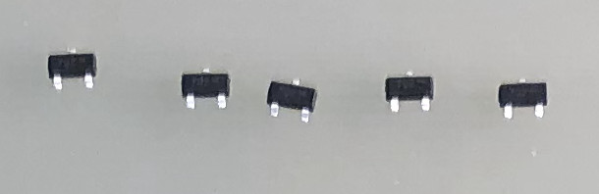
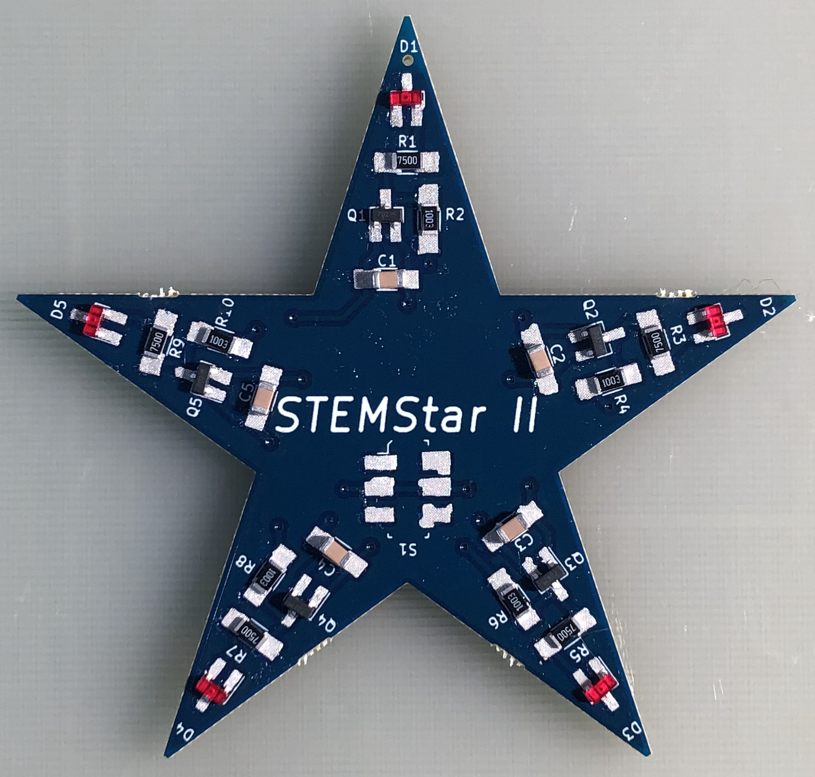
Step 6 – Install Find No. 5
Get Find No 5, MOSFET transistors
Place the parts on the tray with the leads facing down towards the tray and the side with two leads towards you as shown above.
Install the transistors at locations
Q1, Q2, Q3, Q4, Q5
Ensure that the 3 leads on each part are on the pads.

Slide 17
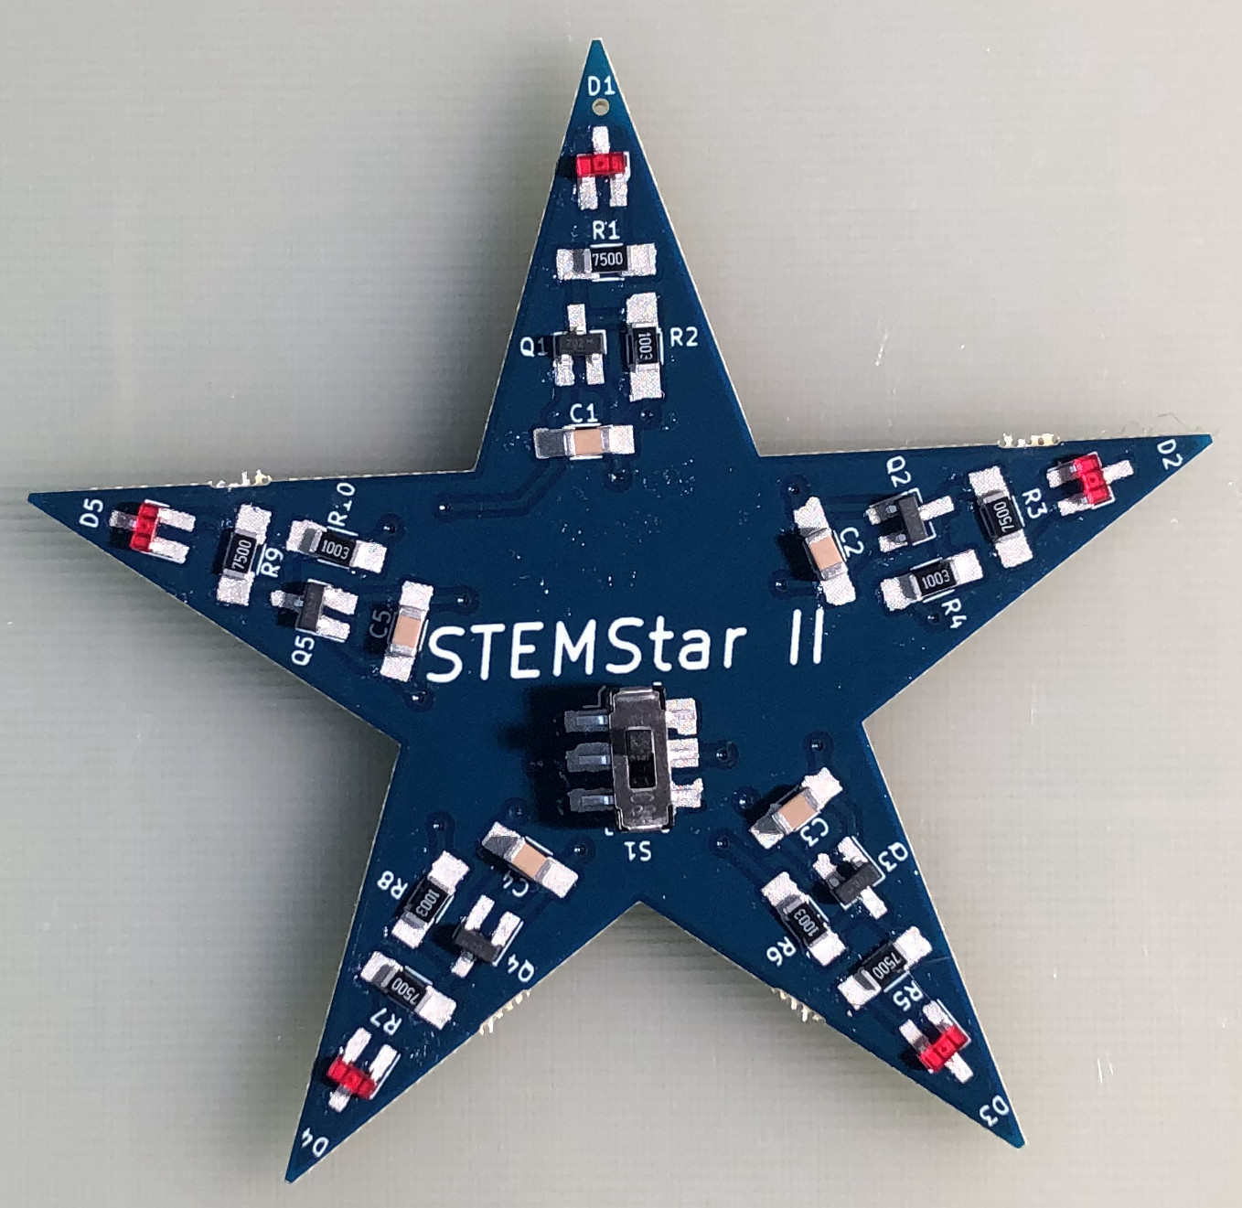
Step 7 – Install Find No. 6
Get Find No 6, Switch.
Install the switch at location S1 as shown. The switch is symmetrical, so it will work correctly regardless of installation orientation

Slide 18
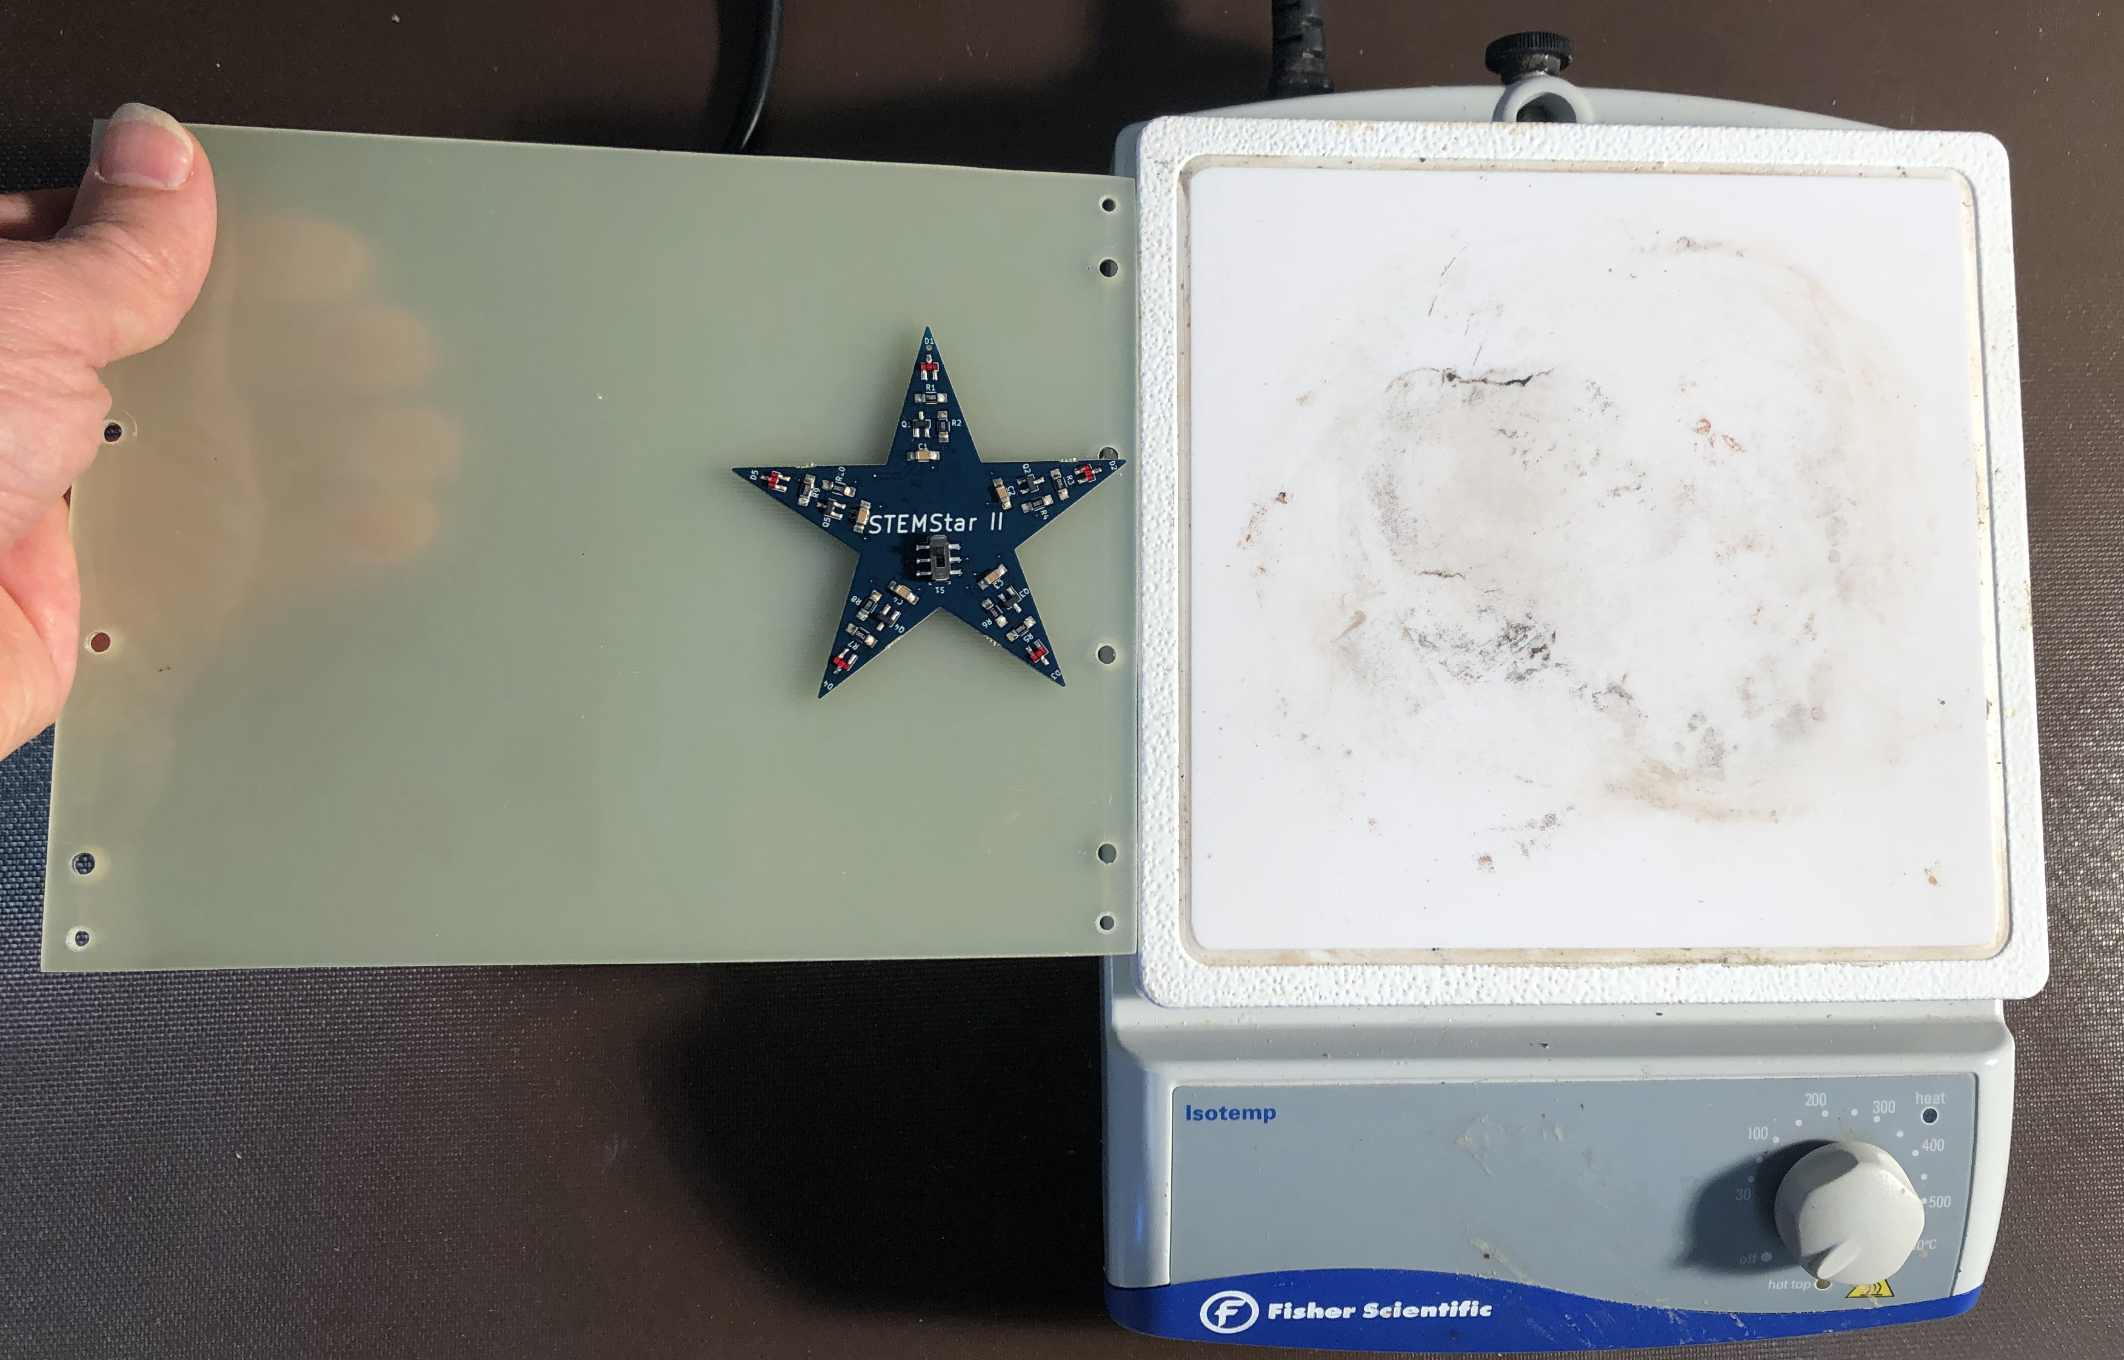
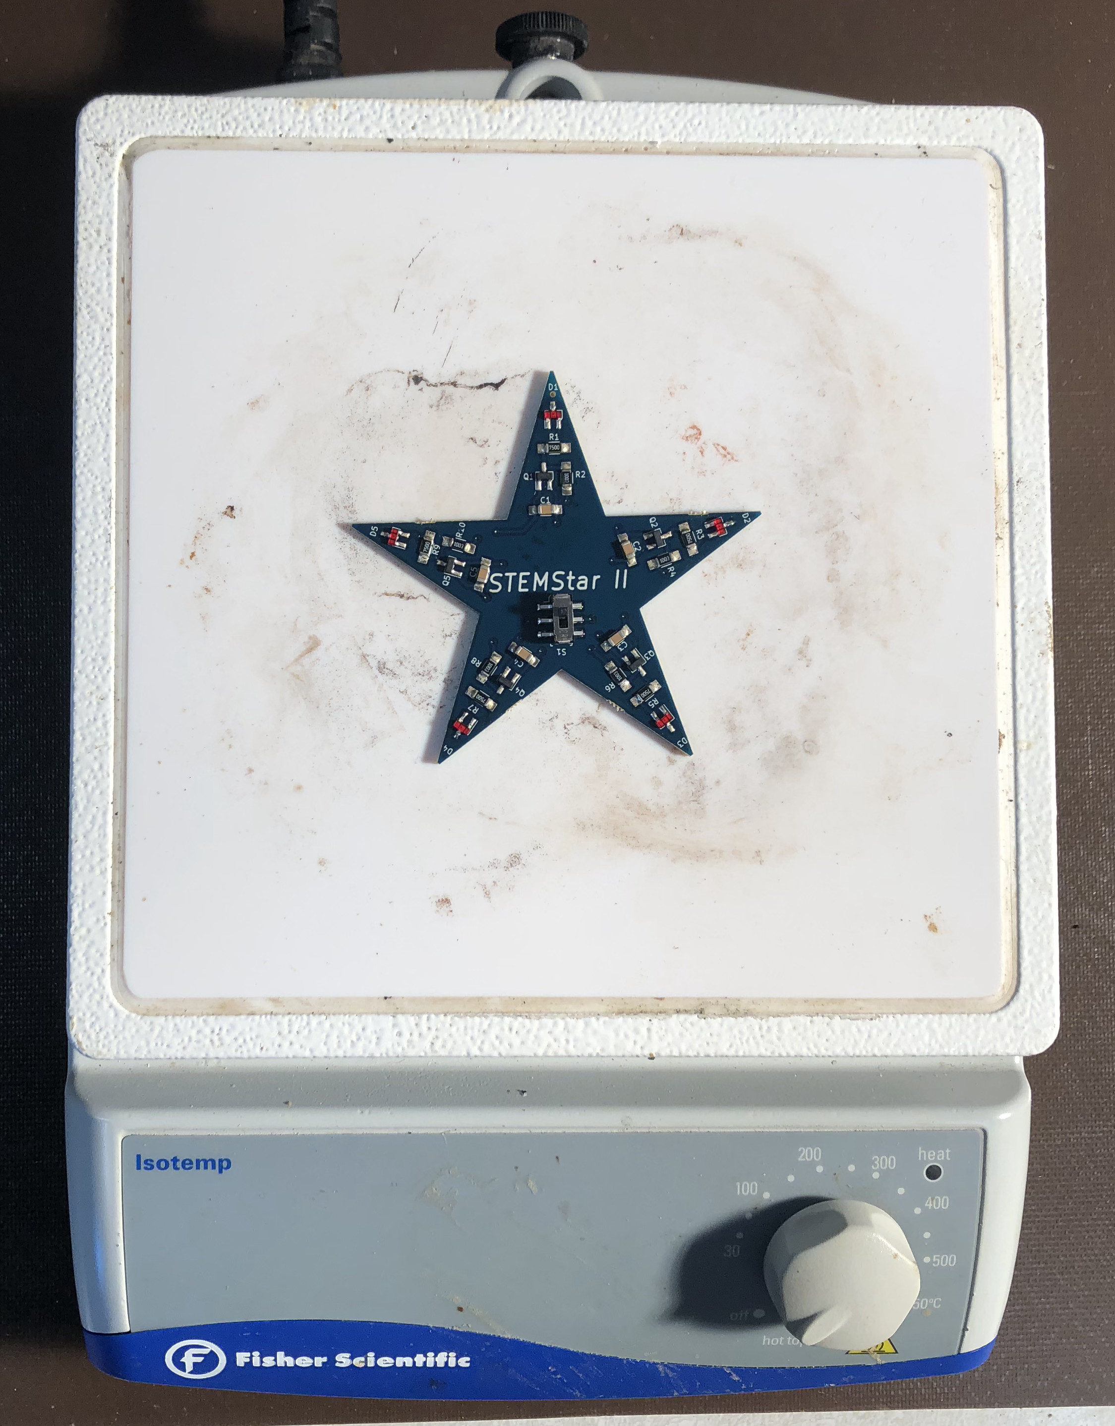
Step 8 – Reflow Time !
Raise your hand and ask for an adult to come over. The adult will help you bring your board over to the reflow station where your board will be placed onto a hot plate so that the solder on your board can melt and attach / connect the parts to your PWB.

Slide 19
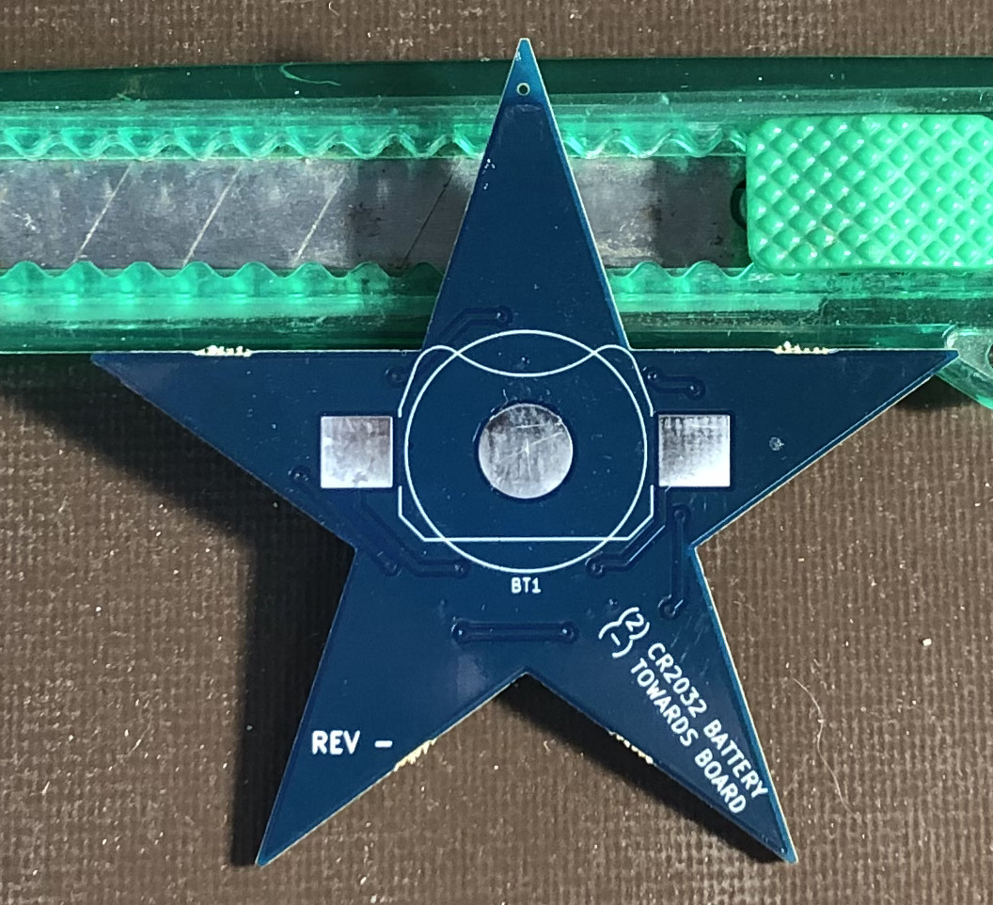
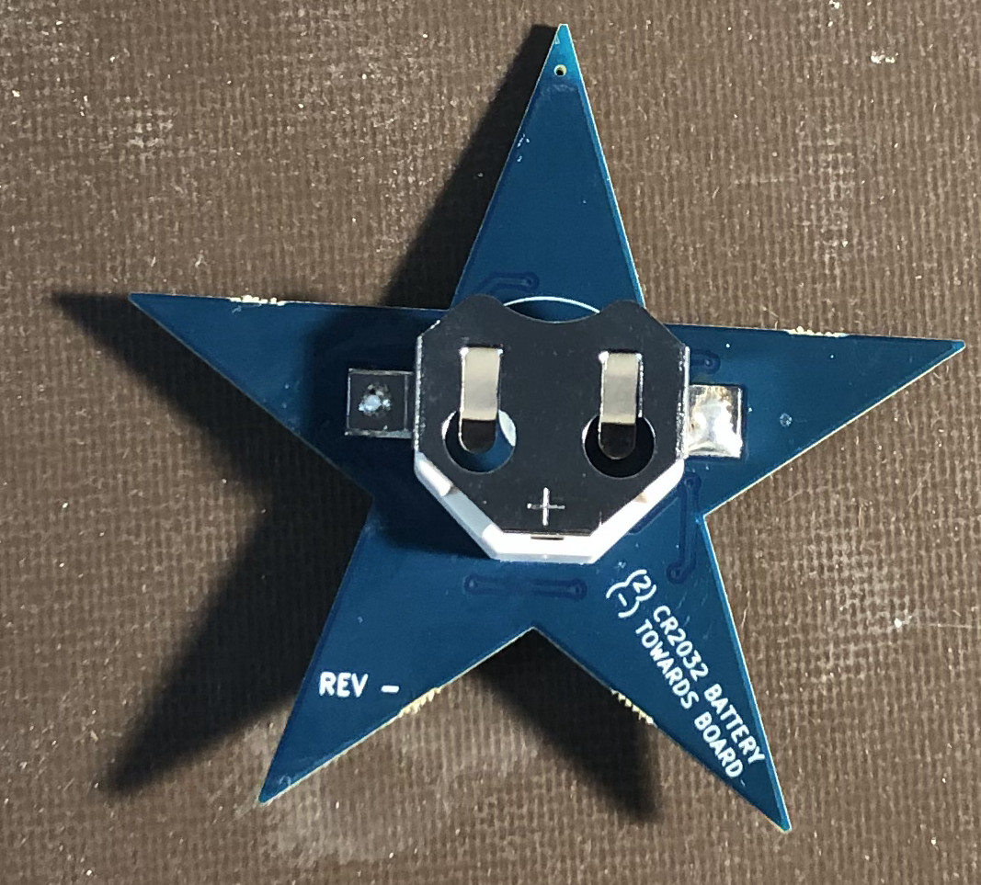
Step 9 – Install Find No. 7
Using lead-free solder and a soldering iron, tin these 3 pads on the backside of the PWB. A stand will likely be required as the parts on the front prevent the board from lying flat.
Tinning the center pad will make it easier for the battery to make good contact.
Apply a small amount of no-clean flux to the two outside pads.
Place the battery holder onto the pads, ensuring that the open side of the holder points towards the top of the board.
Solder the two tabs of the battery holder onto the PWB.

Slide 20
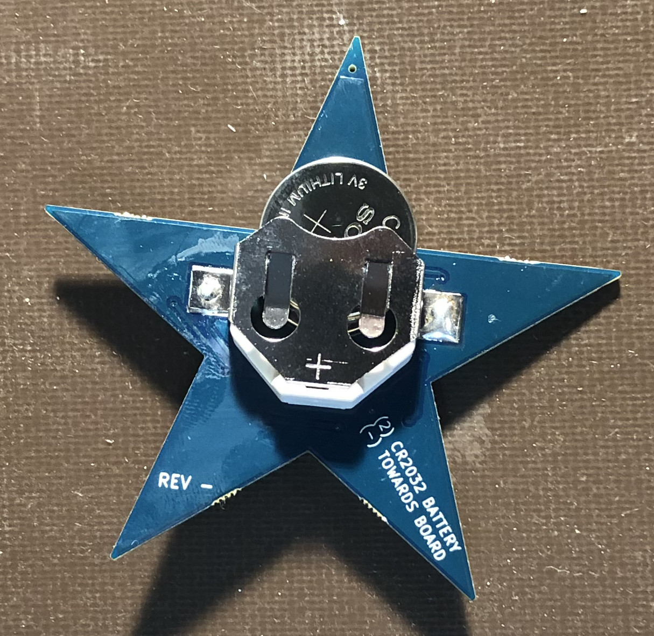
Step 10 – Install Find No. 8
Stack the two CR2032 batteries with their “+” side facing up.
Insert the two batteries into the holder as shown and push all the way in.

Slide 21
Step 11 – Test !
Flip the switch to the “ON” position which is down – See figure.
If everything is working, you will see the lights on the tips of the star “rotating”.

Slide 22
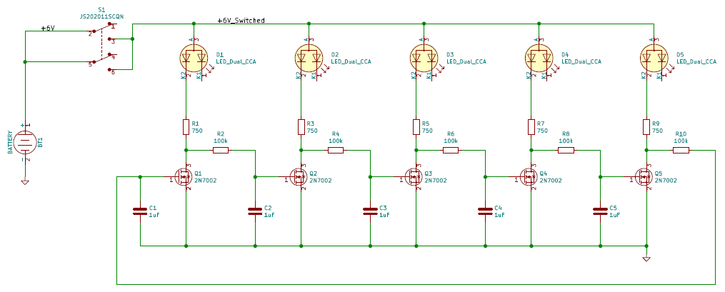
STEMStar II Schematic

Slide 23
LTspice Circuit Simulation Demo
Engineers use circuit simulation software to check the behavior of their deigns before making real hardware.
Circuit simulation software is a great way to learn more about electronics !
STEMStar II was simulated in LTspice which is freely available.
LTSpice can be downloaded here:
  https://www.analog.com/en/design-center/design-tools-and-calculators/ltspice-simulator.html
STEMStar II LTspice file can be downloaded here:
    https://github.com/windgassen/StemStarII/tree/master/LTSpice

Slide 24
STEMStar II Parts List
All STEMStar II design files can be downloaded from my Github site:
https://github.com/windgassen/StemStarII
The PWB for STEMStar II was designed using KiCAD – a free PWB layout tool
http://kicad-pcb.org/

Slide 25
Source Credits for Images / Information
Slide 6 - Electronics – Resistor
  https://openclipart.org/detail/19101/rsa-iec-resistor-symbol
  http://www.learnabout-electronics.org/Resistors/resistors_07.php
Slide 10 & 11 – Electronics – Capacitor
  https://en.wikipedia.org/wiki/Capacitor
  https://en.wikipedia.org/wiki/Spring_(device)
Slide 13 – Light Emitting Diode (LED)
  https://en.wikipedia.org/wiki/Light-emitting_diode
Slide 15 – Electronics – MOSFET
  https://components101.com/mosfets/2n7002-datasheet-pinout-equivalent

